Slide 1
Music Genres Classification
Zhi Wen Huang

Slide 2
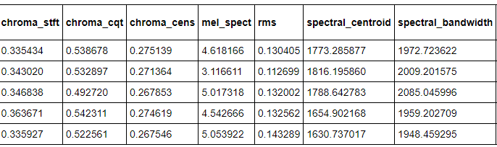
GTZAN Dataset
10 genres
WAV file format
35 Features

Slide 3
Features
Chroma_features (stft, cqt, cens)
Spectral_features (centroid, bandwidth, contrast, flatness, rolloff)
Mel Spectrum
RMS
Poly_features
Tonnetz
ZCR (zero crossing rate)
Tempo
MFCCs (Combine of 20 different MFCs)

Slide 4
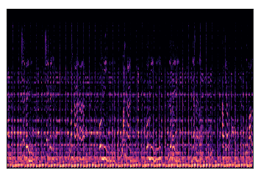
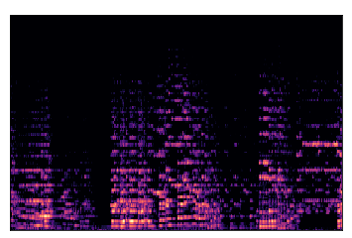
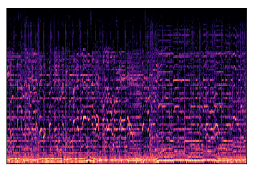
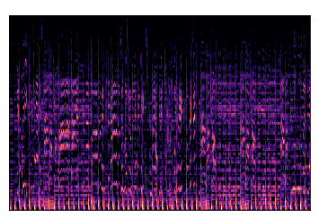
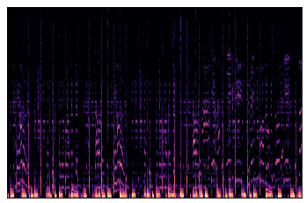
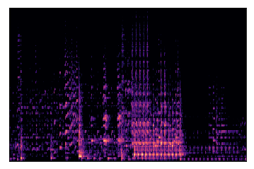
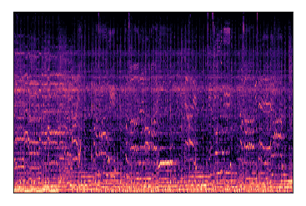
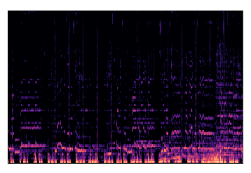
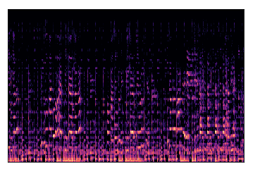
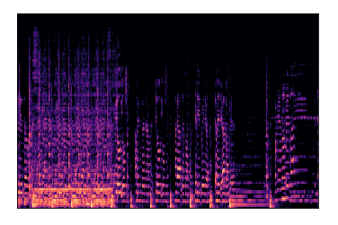
Mel-spectrogram
Blues
Classical
Country
Disco
Hiphop
Jazz
Metal
Pop
Reggae
Rock

Slide 5
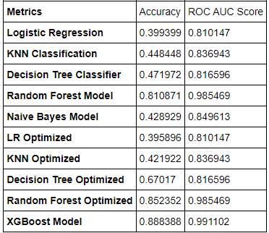
Models and Metrics Measure
Baseline models
Optimized means:
Grid Search
Cross-validation
Takes a lot of time to compute.

Slide 6
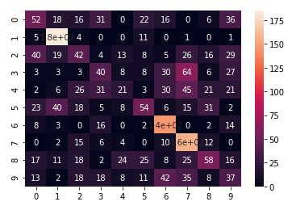
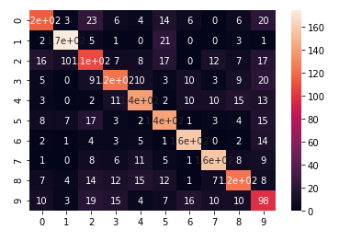
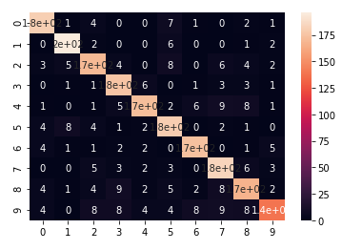
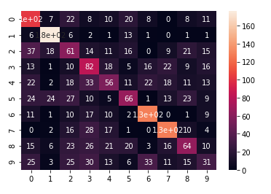
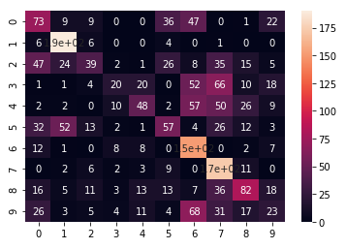
Confusion Matrix
Logistic Regression
Decision Tree
Random Forest
KNN Model
Naïve Bayes

Slide 7
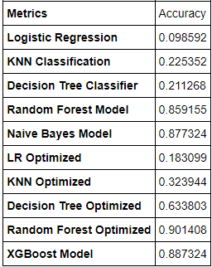
Testing the Models
Canon in D Major
5:50 long sound
Label = classical
Split into 71 chunk of 5 seconds sound
Classify each splits

Slide 8
Future Work
Deep Learning
Convolutional Neural Networks
Apply models to music app

